Slide 1

PRIVATE RESIDENTAL PROPERTY PRICES IN CCR
Data Analytics Capstone Project

Slide 2
TABLE OF CONTENTS
01
02
03
PROBLEM STATEMENT
DATA SOURCE & CLEANING
EXPLORATORY DATA ANALYSIS
04
05
06
MODELLING
DEPLOYMENT
Q & A

Slide 3

03.
01.
PROBLEM STATEMENT

Slide 4
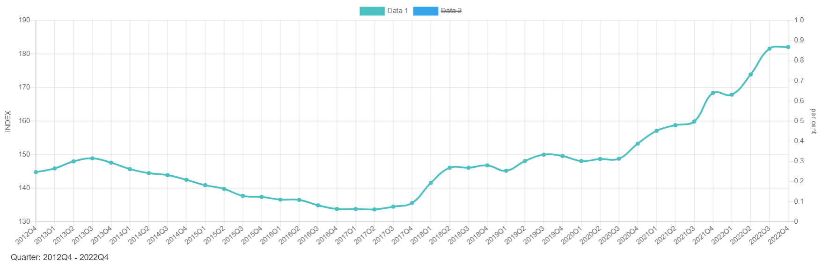
Property Price Index
Source: Urban Redevelopment Authority

Slide 5
Background
Property Price Index (PPI) for Private Residential Properties (non-landed) has been growing at a compounded annual growth rate of 2.3% for the last 10 years.
The y-o-y surge last couple years post-pandemic has been exceptionally strong at 9.9% (in 2021) and 8.1% (in 2022) despite numerous cooling measures.
PPI has been increasing for 6 consecutive years since 2017.
Dire consequences if property market were to collapsed when unusually high prices are not supported by economic fundamentalals.
A need for a systematic approach to estimate intrinsic value of property units to make better-informed decisions instead of just emotional-driven reasons (fear of missing out).

Slide 6
Problem Statement
“Property prices in Singapore have been rising over the last few years. The objective of this project aims to construct a predictive model for the estimation of the intrinsic value of a property unit based on its respective characteristics and features, so as to aid investors in making more informed decisions.”
Scope - a focus on the private residential properties in the core central region (CCR) of Singapore, primarily in district 9, 10 and 11.
Target audience - Property investors and industry analysts who may find this relevant to their works and interests.

Slide 7
03.
02.
DATA SOURCE & CLEANING

Slide 8
Data Source
Urban Redevelopment Authority (URA) website:
www.ura.gov.sg
- Private Residential Property Transactions dataset
- Private Residential Rental Contracts dataset
(data range: Jan-2018 to Mar-2023)
PropertyGuru website:
www.propertyguru.com.sg
- Property listings
- Property projects details

Slide 9
Data Cleaning
Dropped null values
Removed columns irrelevant to analysis.
Standardize all area measurements to sqft.
Adjust date columns from “string” to “date” data type.
Adjust all price and area data from “string” to “float” data type.
Inserted a calculated column “rental psf” (rental divide by unit area) in the rental dataset to have a standard measure across units.
Added a “Proj ID” column to have a unique identifier for each individual project.
Group data by projects and created a table to collect features of respective projects including developer, site area, leasehold, TOP date, property type, distance to mrt etc.

Slide 10
03.
03.
EXPLORATORY DATA ANALYSIS

Slide 11
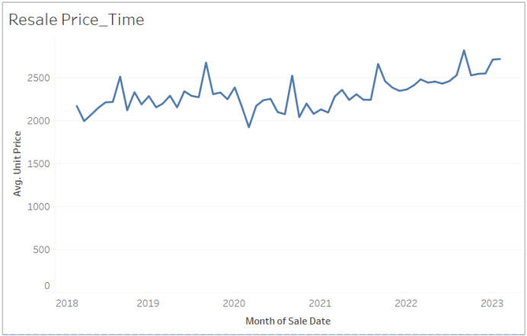
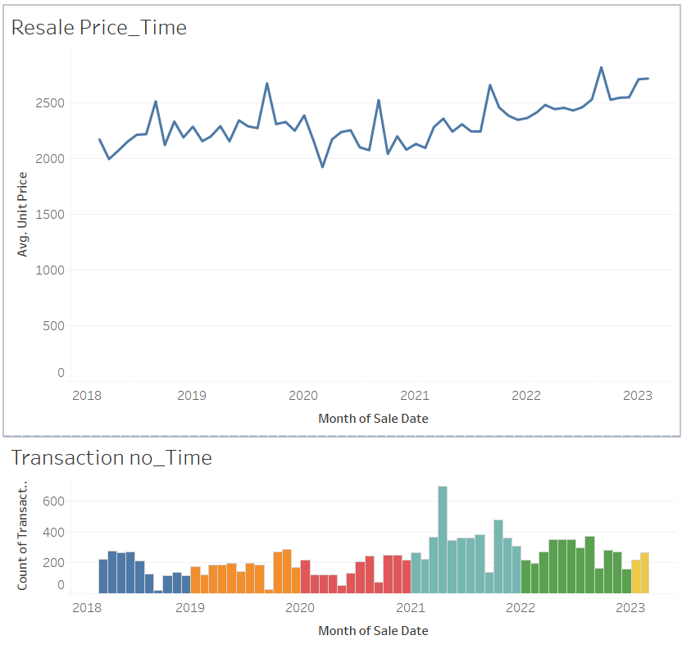
Resale Prices volatile but on a general uptrend

Slide 12
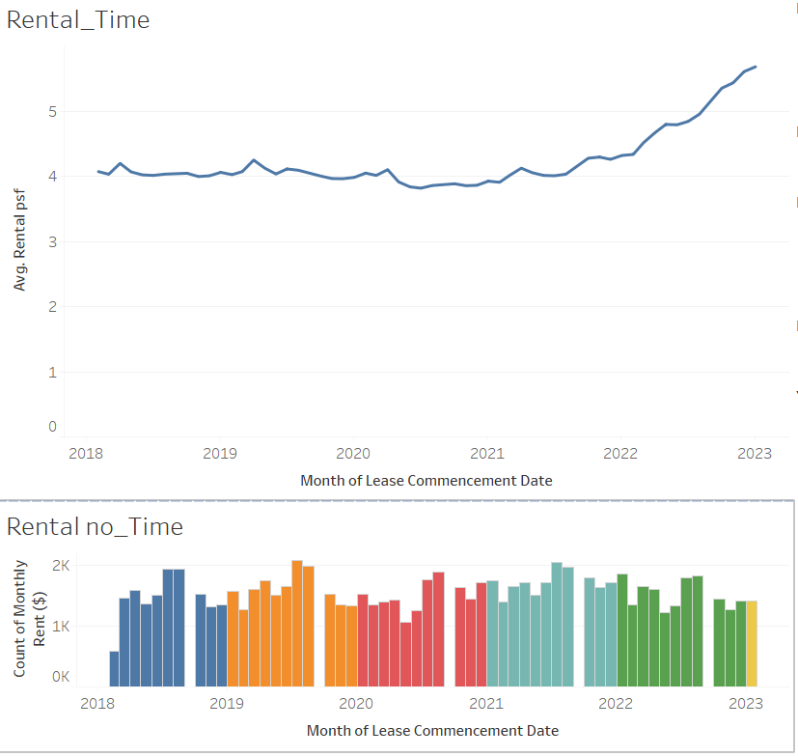
Rental Rates on steady climb from mid-2021

Slide 13
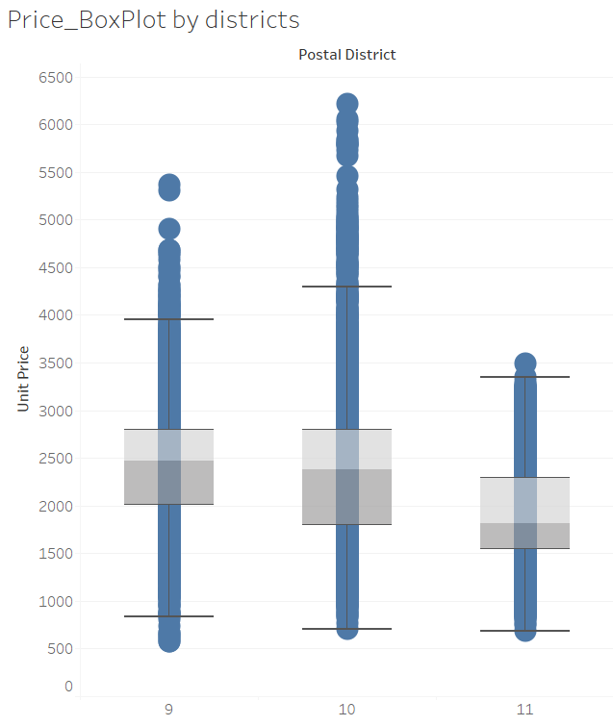
Prices grouped by districts
District 9 has the highest median transaction price across all districts.
District 10 has the greatest range of transaction prices across all districts.

Slide 14
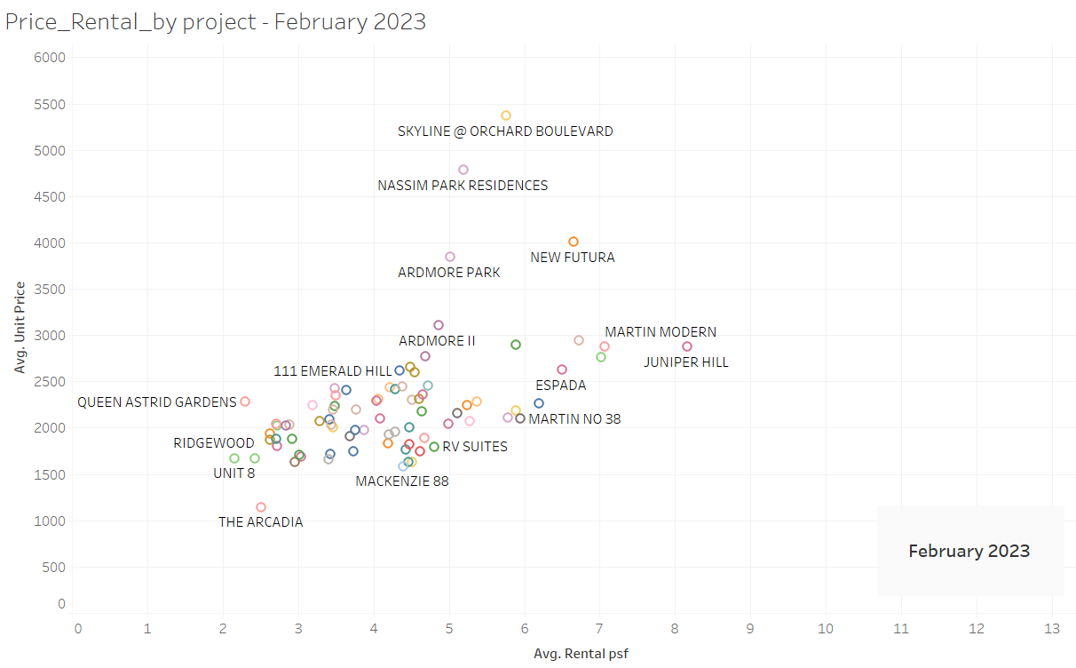
Prices and Rental by Projects - Tableau Animation

Slide 15
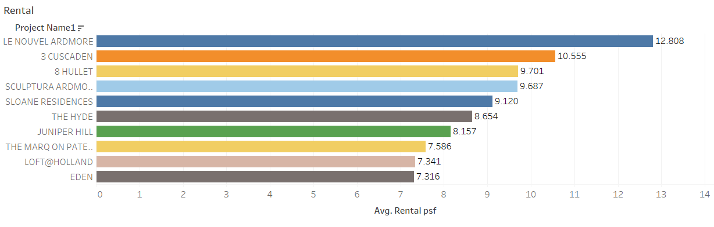
Top 10 Projects By Rental

Slide 16
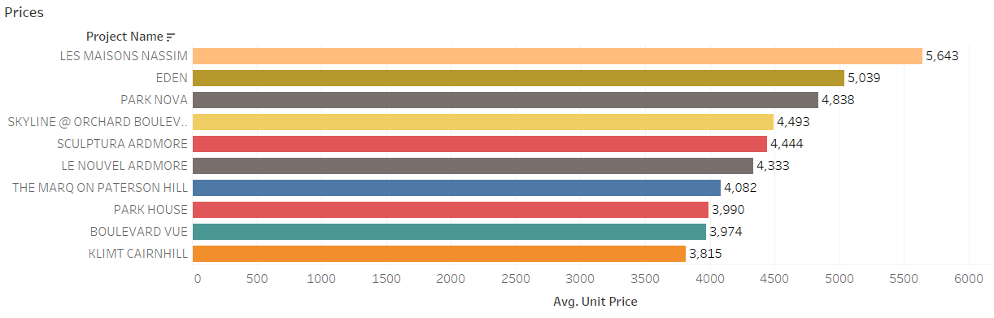
Top 10 Projects By Resale Prices

Slide 17
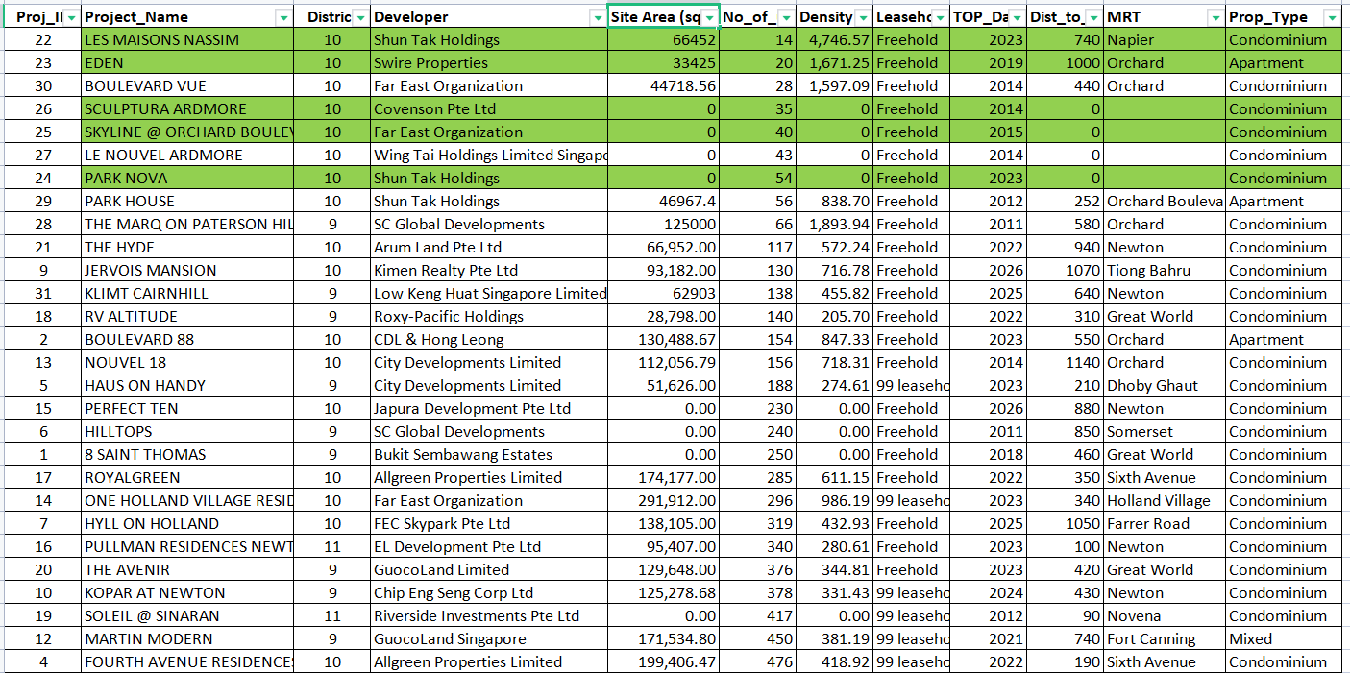
Top Projects Features

Slide 18
03.
04.
MODELLING

Slide 19
Modelling - Preparing Data
Narrowed the scope -
Limit to just projects in the Top 20 by volume and Top 10 by prices that have complete data.
Filtered to total 23 projects with 4,718 transactions for analysis
Drop outliners
Dummify Categorical Features -
PropertyType: Apartment = 1 ; Condominium = 2
Tenure: 99-leasehold = 1 ; Freehold = 2

Slide 20
Different Models
Model | Description | Remarks
Benchmark model | Y = y-mean | Taking mean of y as predicted y value
Simple Linear Regression Model | Y = mX + C | Where Y is dependent variable “Unit_Price”, X is independent variable “Area”, m is coefficient, C is y-intercept
Multi-Factor Linear Regression Model | Y = m1(X1) + m2(X2) + … + m5X5 + C | Where Features X are [Area, PropertyType, Tenure, Unit_Age, Dist_to_mrt]
Random Forest Regressor Model | Y = Averaging of X decision trees | Where Y = “Unit Price” X = “Area”

Slide 21
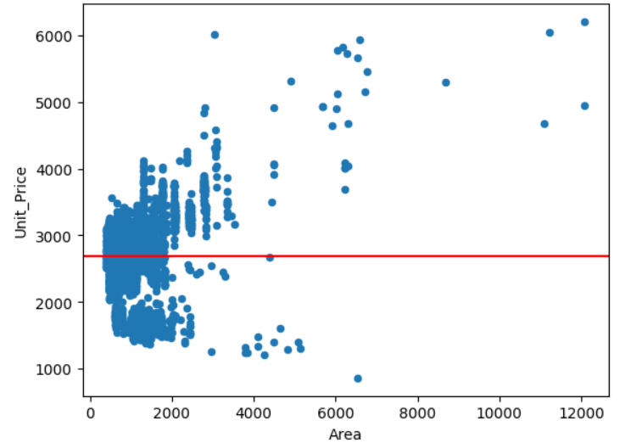

Modelling - Benchmark Model
Formula:
Y = 2,691.04

Slide 22
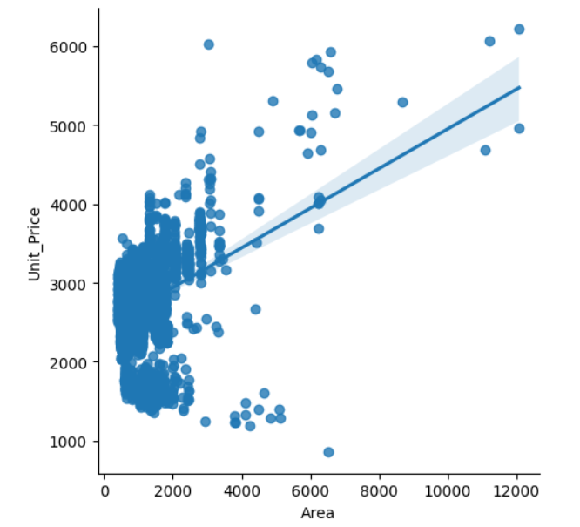

Modelling - Simple Linear Regression Model
Formula:
Y = (0.2367)X + 2,449.2244

Slide 23
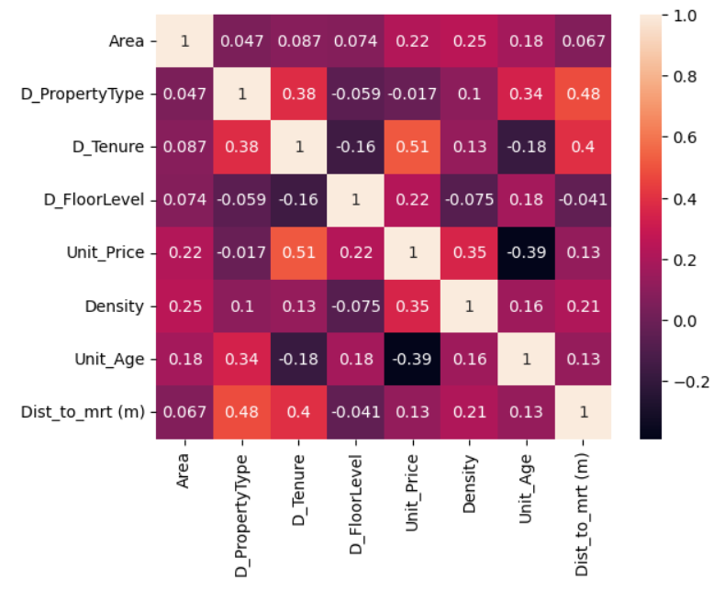
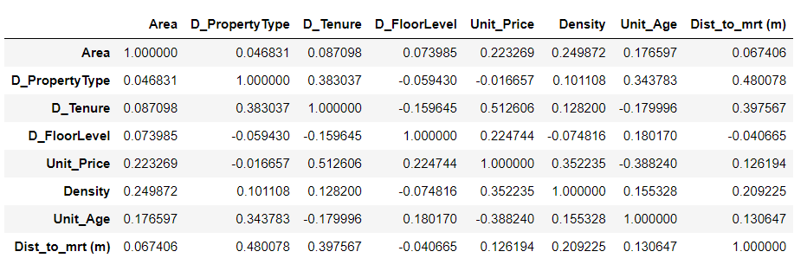
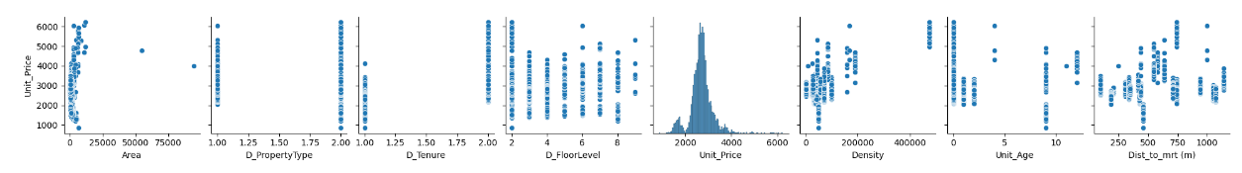
Modelling - Correlation Analysis

Slide 24
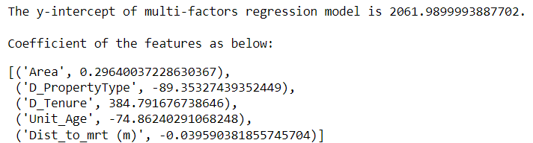

Modelling - Multi-Factor Linear Regression Model
Formula:
Y = (0.2964) X1 + (-89.3533) X2 + (384.7917) X3 + (-74.8624) X4
+ (-0.0396) X5 + 2061.99

Slide 25
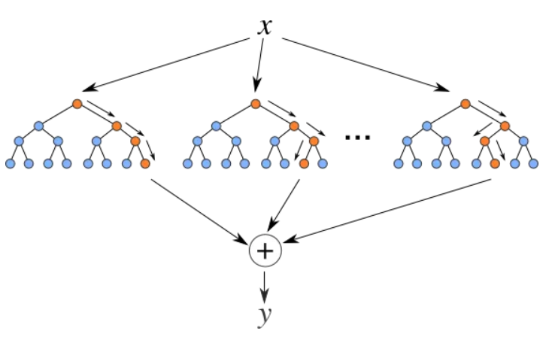
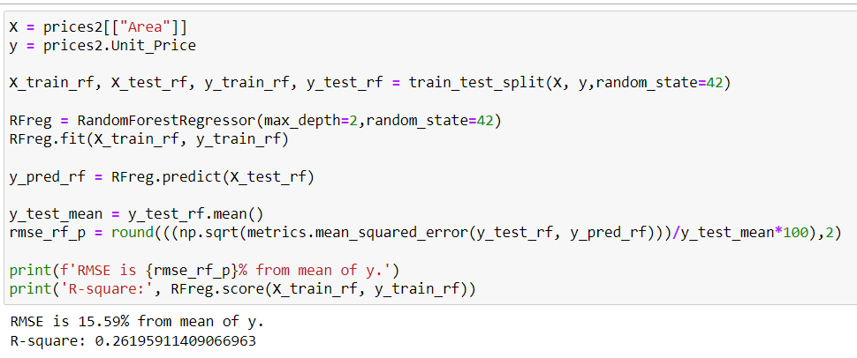
Modelling - Random Forest Regressor Model
Variables:
Y = Unit Price ; X = Area
Parameters:
N_estimators = 100 (default)
Max_depth = 2

Slide 26
Modelling - Results
Model | Description | Remarks | R-square | RMSE as percentage of y-mean
Benchmark model | Y = 2,691.04 | Taking mean of y as predicted y value | NA | 17.59%
Simple Linear Regression Model | Y = (0.2367)X + 2449.2244 | Where Y is “Unit_Price” in psf, X is “Area” in sqft | 0.1306 | 15.70%
Multi-Factor Linear Regression Model | Y = (0.2964)X1 + (-89.3533)X2 + (384.7917)X3 + (-74.8624)X4 + (-0.0396)X5 + 2061.99 | Where X1 = Area in sqft, X2 = Property Type (1=apartment; 2=condo), X3 = Tenure (1=99-leasehold; 2= Freehold), X4 = Unit Age in year, X5 = Distance to mrt in meters | 0.5475 | 11.53%
Random Forest Regressor Model | Y = Averaging of X decision trees | Where Y = “Unit Price” X = “Area” | 0.2620 | 15.59%

Slide 27
03.
05.
DEPLOYMENT

Slide 28
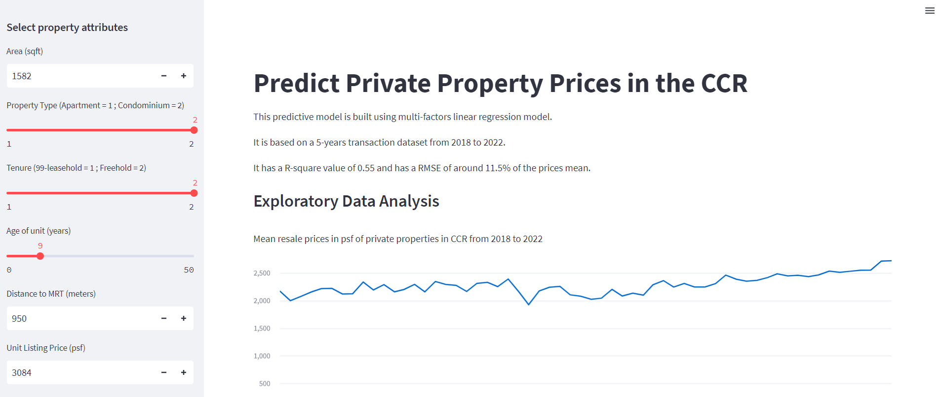
Deployment
https://ngchekwee-capstone-private-property-prop-app-ph450p.streamlit.app/

Slide 29
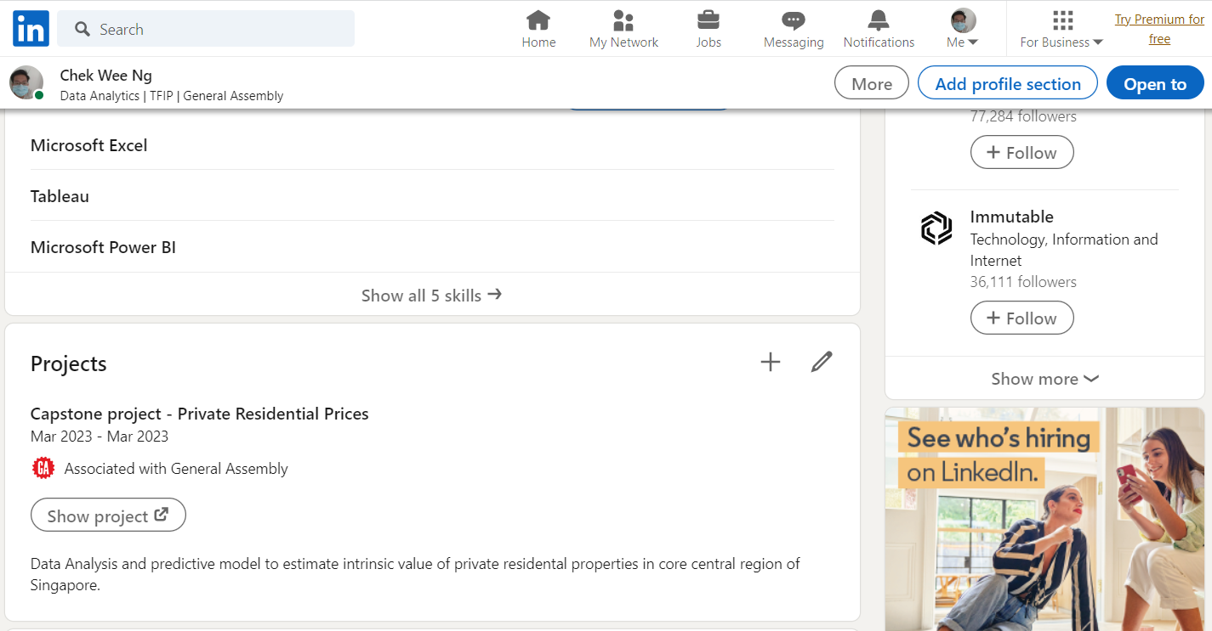
Let’s Connect...
https://linkedin.com/in/ngchekwee/

Slide 30
03.
06.
QUESTIONS & ANSWERS

Slide 31


